Slide 1

MOVIE RECOMMENDATION SYSTEM
Presented BY: Priyanshu
Section : A
University Roll NO : 2016929
Guided By: Dr. Surender Singh Samant

Slide 2
Introduction
What is Recommendation System?
Recommendation system produce a ranked list of items on which a user might be interested, in the context of his current choice of an item.
Subclass of information filtering system that seek to predict the rating or preferences that a user would give to them.
Helps deciding in what to wear, what to buy, what to purchase etc.
Applied in variety of applications like movies.

Slide 3
Algorithms used for Recommendation
Content-Based Filtering
Collaborative Filtering
Content-based filtering uses item features to recommend other items similar to what the user likes.
An ML algorithm used for this strategy recommends motion pictures that are similar to the user’s preferences in the past.
This filtering strategy is based on the combination of the relevant user’s behaviors and other users’ behaviors.
The system compares these behaviors for the most optimal results. It’s a collaboration of the multiple users’ film preferences and behaviors.

Slide 4

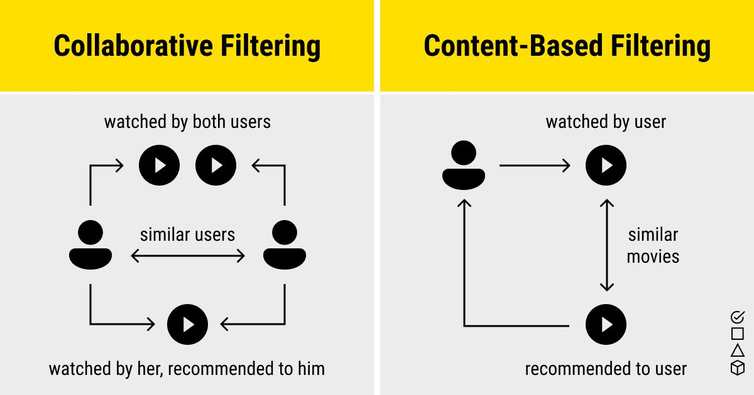





Slide 5
Methodology
Dataset
I have used the IMDB movie recommendation dataset.
This dataset consists of about 5,000 rows and about 20 columns.
Preprocessing
Preprocessing step includes removing of unwanted features like movie budget, release date, etc from dataset.
Combined all the useful features into a single feature and then applied a count Vectorizer to convert the data into a list of vectors.

Slide 6
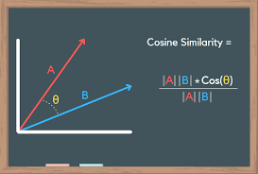
Cosine Similarity
Cosine similarity is a metric used to measure how similar two items are.
It is measured by the cosine of the angle between two vectors and determines whether two vectors are pointing in roughly the same direction.
Cosine similarity measures the similarity between two vectors of an inner product space.
‘0’ means no similarity, whereas ‘1’ means that both the items are 100% similar.

Slide 7
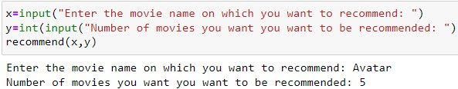
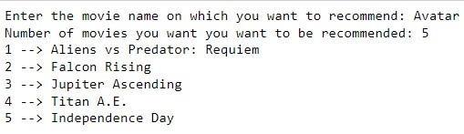
Result and Discussion
Firstly, user enter the movie name and number of recommendations regarding which user wants the recommendation.
We find cosine similarity of the input movie with every movie present in the dataset and predict those top movies having the highest cosine similarity.
List of recommended movies

Slide 8

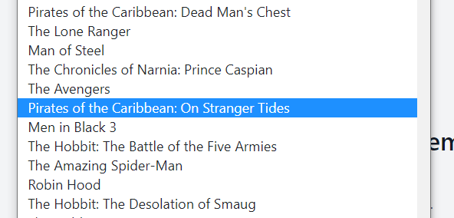
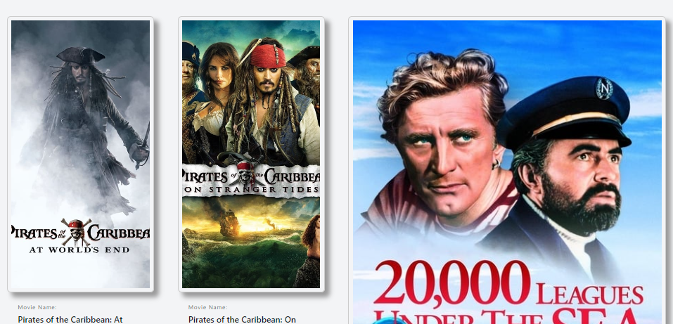
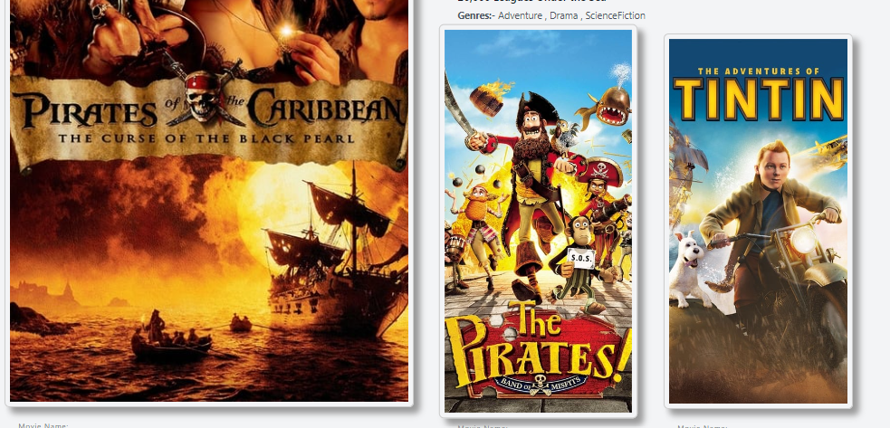

Slide 9
Conclusion and future work
Conclusion
I have used cosine similarity algorithm to recommend the movies similar to the user’s choice.
After analyzing the output, it is observed that our model is working quite well.
Future Work
Future research will deal with advancing the prevailing techniques and algorithms to enhance the nice of recommender structures predictions and hints.

Slide 10


